Slide 1
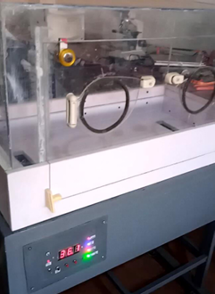
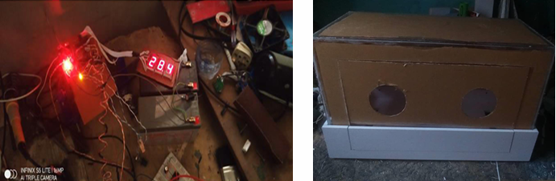
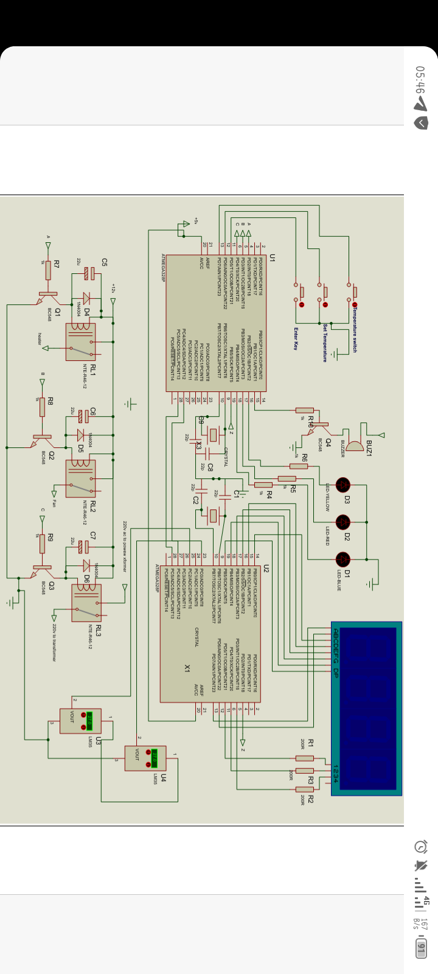
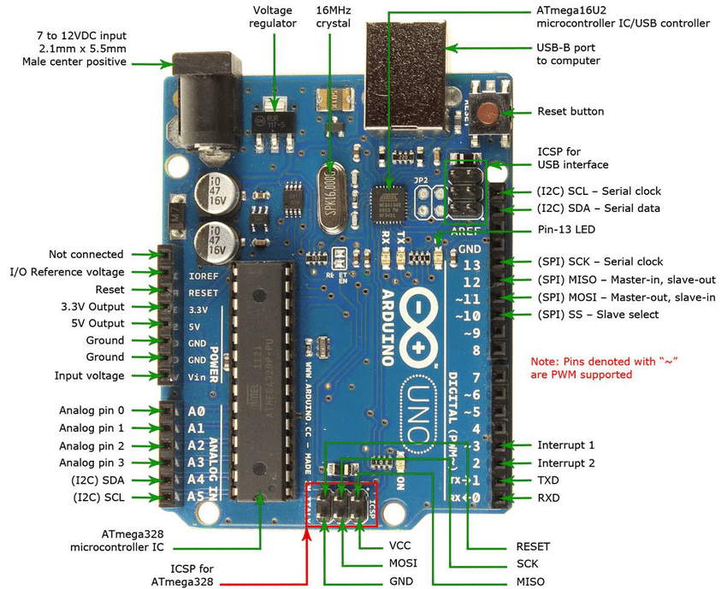
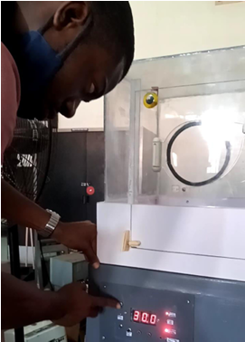




AN INFANT INCUBATOR DESIGN FOR INTERMITTENT TO ELECTRICITY
Okwuegbulem, Anthony¹ Chukwudi, Francis.O.¹ Ephraim, Dominic E.¹ Abe Olaoluwa, O² Alele, Grace.O.,³ Olutosoye, Taiwo. C.,⁴ Olumati Aroumachi. K., Oludayo, Kayode. E.
Biomedical Engineering Department
University of Ibadan, Ibadan
PROBLEM STATEMENT
ECONOMIC IMPORTANCE
.
Preterm infant deaths are often caused by heat loss and dehydration as the prematurely-born babies cannot regulate their body temperatures when temperature of the environment changes. This can be prevented through the administration of proper medical care with the help of an incubator lasting for a long period of time even when there is power outage. However, most incubators run on electricity, therefore countries like Nigeria where there is acute shortage of electricity, the existing expensive infant incubator is of little or no use
The era of energy savings plus the system power backup makes the designed infant incubator have much impact to the society, being a relevant medical device that provides controlled environments for preterm babies with illness or disability and will also serve like a second womb or a safe bubble surrounding the baby.
Methodology
DESCRIPTION OF SOLUTION
The incubator consists of a 12v/150w PTC heater, filtered fans for warmed air circulation, an Arduino Uno Board using Atmega328p microcontroller, a container of distilled water for humidity, and a 12v/15Ah inbuilt battery backup power pack which can last up to 120mins.
The proposed solution to the problem stated would be a reduced-cost device using available materials to design and develop an infant incubator which can continuously maintain a temperature within a specified range in order to constantly keep the baby warm even with an intermittent access to electricity.
FUTURE WORK
To have the chamber made with ceramic, interfacing solar panel to the incubator and also increasing the battery rating for more power backup

